Slide 1


LESSON 9
SPHERICAL TRIGONOMETRY

Slide 2
TERMS and DEFINITIONS
  Spherical Trigonometry – is a branch of trigonometry that concerns with triangles extracted from the surface of the sphere.
  Sphere – is a three the dimensional surface, all points of which are equidistant from a fixed point called the center.
  Great Circle – is a circle obtained by passing a section through the center of the sphere.
  Lune – is that part of the surface of a sphere bounded by the arcs of two great circles.
  Spherical Triangle – is that part of the surface of a sphere bounded by three arcs of great circles.
  Right Spherical Triangle – is a spherical triangle having a right angle.

Slide 3

SPHERICAL TRIANGLE
A spherical triangle is that part of the surface of a sphere bounded by three arcs of great circles. The bounding arcs are called the sides of the spherical triangle and the intersection of these arcs are called the vertices. The angle formed by two intersecting arcs is called a spherical angle.
C
A
A
b
B
O
C
c
O
a
B

Slide 4
Related Propositions from Solid Geometry
If two angles of a spherical triangle are equal, the sides opposite are equal; and conversely.
If two angles of a spherical triangle are unequal, the sides opposite are unequal; and conversely.
The sum of any two sides is greater than the third side, that is,
a + b > c, a + c > b, b + c > a
The sum of the three sides is less than 360⁰, that is,
0⁰ < a + b + c < 360⁰
The sum of any two angles is less than 180⁰ plus the third angle, that is,
A + B < 180⁰ + C, A + C < 180⁰ + B, B + C < 180⁰ + A
The sum of the angles is greater than 180⁰ and less than 540⁰, that is,
180⁰ < A + B + C < 540⁰

Slide 5
RIGHT SPHERICAL TRIANGLE
Napier’s Circle
B
co - B
a
a
c
co - c
b
co - A
A
C
b
Where:
co – A = complement of A
co – B = complement of B
co – c = complement of c

Slide 6
NAPIER’S RULE
NR1: The sine of any middle part is equal to the product of the tangents of the adjacent parts.
NR2: The sine of any middle part is equal to the product of the cosines of the opposite parts.
THEOREMS ON QUADRANTS
Theorem 1: In a right spherical triangle, any side and the opposite angle terminate in the same quadrant.
Theorem 2: (a) If any two of the three sides a, b, and c terminate in the same quadrant, the third terminates in the first quadrant.
(b) If any two of the three sides terminate in different quadrants, the third terminates in the second quadrant.

Slide 7
FUNDAMENTAL FORMULAS:
tan a = tan c cos B
tan a = sin b tan A
tan b = sin a tan B
tan b = tan c cos A
cos c = cot A cot B
sin a = sin c sin A
sin b = sin c sin B
cos c = cos a cos b
cos A = cos a sin B
cos B = cos b sin A

Slide 8
EXAMPLE:
Solve the following right spherical triangle: (C = 90⁰)
a = 50⁰20’ c = 80⁰30’
a = 45⁰57’ b = 68⁰27’
B = 52⁰37’ b = 48⁰20’
B = 48⁰25’ b = 52⁰17’
a = 98⁰52’ A = 38⁰14’

Slide 9
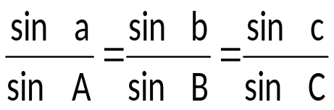
OBLIQUE SPHERICAL TRIANGLE
LAW OF SINES:
LAW OF COSINES FOR SIDES:
cos a = cos b cos c + sin b sin c cos A
cos b = cos a cos c + sin a sin c cos B
cos c = cos a cos b + sin a sin b cos C
LAW OF COSINES FOR ANGLES:
cos A = – cos B cos C + sin B sin C cos a
cos B = – cos A cos C + sin A sin C cos b
cos C = – cos A cos B + sin A sin B cos c

Slide 10
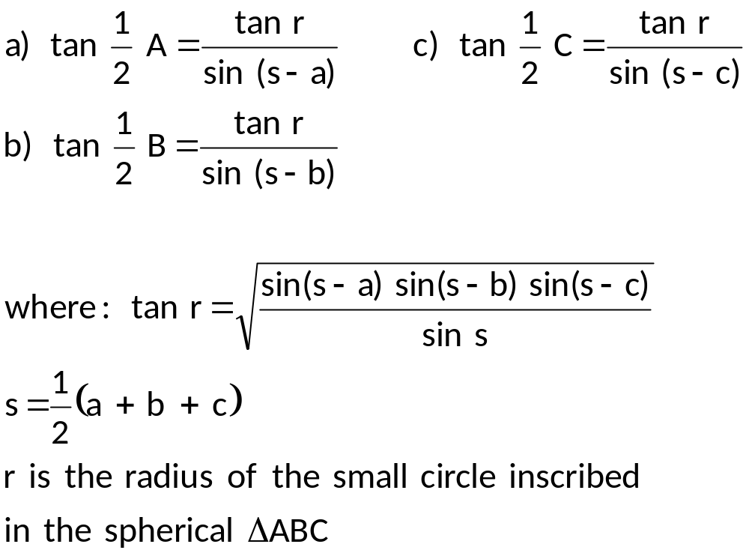
USEFUL FORMULAS
HALF – ANGLE: (used to find angles of a spherical triangle when three sides are given)

Slide 11
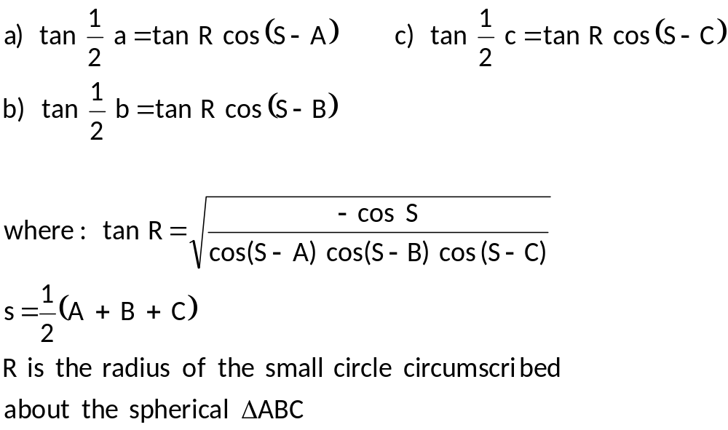
HALF – SIDE: (used to find sides of a spherical triangle when three angles are given)

Slide 12
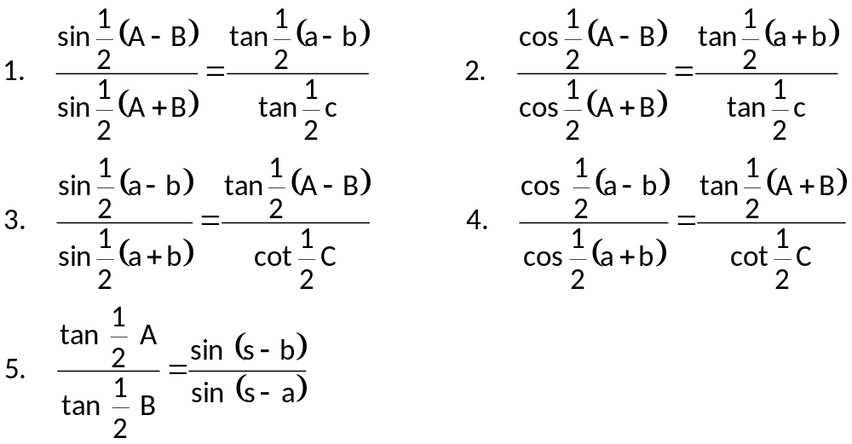
NAPIER’S ANALOGIES:

Slide 13
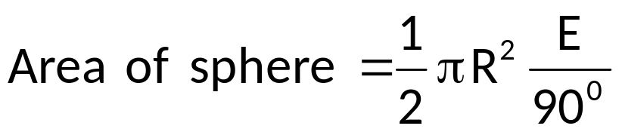
TERRESTRIAL SPHERE
where: E = spherical excess in degrees
E = ( A + B + C) – 180

Slide 14
Solution of oblique spherical triangle involves six cases, namely:
Case 1: Two sides and included angle are given.
Case 2: Two angles and the included side.
Case 3: Two sides and an angle opposite one of them.
Case 4: Two angles and a side opposite one of them.
Case 5: Three sides are given.
Case 6: Three angles are given.

Slide 15
EXAMPLE:
Solve the following triangles.
a = 99⁰ b = 69⁰ B = 70⁰
a = 85⁰ b = 65⁰ c = 105⁰
A = 77.03⁰ B = 62.44⁰ C = 109.11⁰
A = 77.03⁰ B = 62.44⁰ c = 105⁰
a = 85⁰ b = 65⁰ A = 77.03⁰
A = 77.03⁰ B = 62.44⁰ a = 85⁰
a = 75⁰ b = 110⁰ C = 72⁰
c = 113⁰ B = 66⁰ A = 110⁰
a = 54⁰ b = 25⁰ A = 101⁰
a = 25⁰ B = 108⁰ A = 59⁰
a = 51⁰ b = 81⁰ c = 115⁰
A = 58⁰ B = 143⁰ C = 25⁰

